Slide 1
Act 861 of 2012
Bullying Prevention in Louisiana’s Schools
Notes:
The Louisiana Department of Education would like to thank you for taking the time to view this important training. The objective of this presentation is to provide you with information to improve your bullying prevention efforts while fulfilling the legal requirements of Act 861 of 2012. The purpose of the training is to ensure that all stakeholders (including faculty and staff, students, and parents) are fully informed about the requirements of the new bullying law including the reporting, investigation, and documentation requirements.
We all know that bullying is a very serious matter and should be treated that way. The procedures and requirements that follow were developed to ensure that everyone, including the Louisiana Department of Education, does everything that can be done to reduce bullying in our schools.
All LEA’s and schools are required to implement policies, practices, and procedures to address bullying, but more importantly, to put in place a comprehensive proactive, prevention program to reduce the need to reactively and punitively address its occurrence.
In the event you should need any further explanation or clarification, please do not hesitate to get in touch with the Department staff using the contact information provided at the end of this presentation.

Slide 2
Act 861 of 2012
Purpose
The purpose of Act 861 is to ensure that all school districts have and maintain a uniform policy to provide equal protection, for all Louisiana public school students, against bullying. This Act is known as the "Tesa Middlebrook Anti-Bullying Act.“
Summary
Act 861 of the 2012 Regular Legislative Session required the LDOE, in collaboration with BESE, to develop procedures and regulations with regard to the proper reporting and investigating of an incident of bullying. These procedures include but are not limited to adoption of BESE-approved forms for reporting and investigating incidences of alleged bullying, proper parental notification, and mandatory orientation provided to faculty/staff/ students/parents. It also provides parents/legal guardians the right to appeal when a timely and effective investigation has not been conducted.
Notes:
The purpose of Act 861 is to ensure that school districts adopt uniform policies to provide all students protection from bullying. The Act requires the Department, school districts, and schools to do very specific things to address bullying in all Louisiana’s public schools. In this presentation we will take an in depth look at the specific requirements of Act 861 and how these may be carried out.

Slide 3
Definition of Bullying
A pattern of one or more of the following:
• gestures, including but not limited to obscene gestures and making faces;
• written, electronic, or verbal communications, including but not limited to calling names, threatening harm, taunting, malicious teasing, or spreading untrue rumor;
• electronic communication including but is not limited to a communication or image transmitted by email, instant message, text message, blog, or social networking website through the use of a telephone, mobile phone, pager, computer, or other electronic device;
• physical acts, including but not limited to hitting, kicking, pushing, tripping, choking, damaging personal property, or unauthorized use of personal property;
• repeatedly and purposefully shunning or excluding from activities;
Notes:
So, what is bullying and how do we define it in Louisiana?
Act 861 defines bullying to include behaviors such as gestures, name calling, threatening harm, physical acts such as hitting and damaging of property, and purposeful exclusion from activities. This law also includes bullying through electronic means such as email, text messages, or social networking sites.

Slide 4
Definition of Bullying
Where the pattern of behavior is exhibited toward a student, more than once, by another student or group of students and occurs, or is received by, a student while on school property, at a school-sponsored or school-related function or activity, in any school bus or van, at any designated school bus stop, in any other school or private vehicle used to transport students to and from schools, or any school sponsored activity or event.
The pattern of behavior must have the effect of physically harming a student, placing the student in reasonable fear of physical harm, damaging a student’s property, placing the student in reasonable fear of damage to the student’s property, or must be sufficiently severe, persistent, and pervasive enough to either create an intimidating or threatening educational environment, have the effect of substantially interfering with a student’s performance in school, or have the effect of substantially disrupting the orderly operation of the school.
Notes:
According to Act 861, a pattern of any of the behaviors must occur more than once and must place the student in reasonable fear of physical harm or be pervasive enough to impact the learning environment or interfere with a student’s academic performance.

Slide 5
What Our Data Says about Bullying in Louisiana
According to data gathered by the Louisiana Department of Education’s Student Information System (SIS), during the 2011-2012 school year, approximately 2,600 students were reported to have been a victim of a bullying incident.
According to the 2011 Youth Risk Behavior Survey (YRBS) results, 19.2% of Louisiana students reported that they had been bullied on school property as compared to 20.1% nationwide.
Data from the 2010 Caring Communities Youth Survey administered to 6, 8, 10, and 12 graders indicate that although bullying is a problem at all grade levels, younger students (elementary and middle school) report being a victim of bullying more often than older students (high school) (27.9%, 22.8%, 15.7%, and 9.7% respectively)
Notes:
Bullying is a serious problem in many of our nation’s schools and comes with a host of negative academic and social outcomes impacting students. Students who have been bullied on school campus often feel less safe and less connected to their school. They are more likely to engage in risky health behaviors such as alcohol or substance use and often experience mental health issues. Most importantly, being a victim of bullying can negatively impact school attendance and ultimately academic performance.
According to data gathered by the Louisiana Department of Education’s Student Information System, approximately 2,600 students were reported to have been a victim of bullying during the 2011-2012 school year.
Data gathered from the Youth Risk Behavior Survey and the Caring Communities Youth Survey indicate that approximately 19% of Louisiana students reported that they have been bullied and that bullying, although a problem at every grade level, occurs more often among younger students.

Slide 6
Louisiana Department of Education Responsibilities
Develop rules, regulations, and procedures for the implementation of Act 861 of 2012
Develop a form for the purpose of reporting bullying for use by students, school staff, and parents
Develop procedures for investigation into a reported incident of bullying
Post and track any complaints received at the Department on the LDOE website
Notes:
Act 861 required the Louisiana Department of Education to do four specific things. In collaboration with the Board of Elementary and Secondary Education, the department is responsible for developing rules, regulations, and procedures for the implementation of Act 861.
To meet this requirement, the Department has put together documents to provide guidance on how incidents of bullying may be handled from the reporting of the incident to the final documentation of the outcomes of an investigation. These documents are one of several resources provided in the Bullying Prevention Toolkit on the Louisiana Department of Education’s website.
Also the Department is required to develop a process to track and post any complaints related to bullying and the fulfillment of Act 861 on the department’s website. This piece will be discussed in more detail later in this presentation.

Slide 7
LEA Responsibilities
Develop and implement school staff orientation and mandated 4 hours of training to include:
How to recognize bullying behavior
How to identify those most likely to become victims
How to use appropriate interventions for bullying
Procedures for properly reporting an incident of bullying
Information on suicide preventions, including the relationship between suicide risk factors and bullying
Use content that is based on information supported by peer-reviewed research
Notes:
Act 861 requires LEA’s to do three specific things. The first is to create a program to provide the mandated four hours of bullying prevention training. The 4 hours of training are required to ensure that all staff members are prepared and equipped to proactively prevent bullying and know how to appropriately intervene if they witness a bullying incident.
The law does not mandate how and when the training will be carried out. It is left to the discretion of the LEA but must include the specifics mentioned on this slide.
The Department has put together several optional resources that may assist LEAs with meeting the training requirements of Act 861. These resources can be found in the Bullying Prevention Toolkit on the Department’s website.

Slide 8
LEA Responsibilities
By no later than January 1, 2013, review and revise, if necessary, the Student Code of Conduct to address:
Definition of the behavior constituting bullying
The effect the behavior has on others
The disciplinary and criminal consequences of bullying another student
Disciplinary consequences for false reporting of a bullying incident
Develop and integrate into the Student Code of Conduct a Bullying Policy that:
Includes the definition of bullying
Is implemented in an ongoing manner throughout the school year
Integrated into the school’s curriculum, discipline policies, and other violence prevention efforts
Notes:
Secondly, Act 861 requires LEA’s to review and revise the Student Code of Conduct to reflect changes in the law by January 1, 2013.
The Student Code of Conduct must include a separate policy prohibiting bullying. The policy must include the definition of bullying and the consequences of bullying another student. This policy should be implemented throughout the school year and be integrated into the school’s curriculum and other violence prevention efforts.
A sample policy is included in the optional resources on the Department’s website.

Slide 9
LEA Responsibilities
As required under R.S. 17:416.20, students should be informed orally and in writing at the orientation to be conducted within the first five days of school of the prohibition against bullying including:
The definition of and the behavior constituting bullying
The consequences of bullying another student
The proper procedures for reporting an incident of bullying to the school
A copy of the written notice must be delivered to each student’s parents or legal guardians.
Notes:
Last, Act 861 requires that students be informed of the bullying policy both orally and in writing. Students should be informed during the student orientation required under R.S. 17:416.20 and should be informed of both the definition of bullying and the consequences for bullying another student. Students should be also informed of the proper procedure for reporting a bullying incident to the school.
Parents and legal guardians should also be provided a written copy of the bullying policy. A sample letter to inform parents of the district’s policy against bullying is included in the Bullying Prevention Toolkit found on the Department’s website.

Slide 10
School/Principal/Designee Responsibilities
REPORTING
The principal of each school must publicize the procedure of reporting a bullying incident and establish how this report will be acted upon.
The principal or principal’s designee is responsible for receiving complaints alleging violations of the bullying policy.
Notes:
Act 861 requires schools to have procedures in place to receive reports of bullying and effectively investigate and address these reports of bullying. The law requires that each school prominently publicize the procedure for reporting bullying. Each principal may define how this looks in his or her schools.
However, all reports of bullying must be submitted in writing using the Louisiana Department of Education’s Bullying Report Form.
A principal is responsible for receiving complaints regarding bullying. It is understood that in larger schools it may not be feasible for the principal to personally handle every report. In this instance, the law provides that a principal may designate another staff member such as an assistant principal or school counselor as his or her designeeto investigate all instances of bullying.

Slide 11
Bullying Report Form
Any individual (teacher, parent, student, parent chaperone, etc.) reporting an incident of bullying must do so on the Louisiana Department of Education’s Bullying Report Form.
Notes:
Any individual at the school who reports an incident of bullying must do so on the Louisiana Department of Education’s Bullying Report Form. Students and parents are encouraged to report any incident of bullying to the school. However, this law REQUIRES that any teacher, school staff member, or any parent chaperoning a school sponsored event report an incident of bullying.
All reports of bullying should remain as objective as possible. School employees should fill out the report completely and legibly. Report only what you are certain occurred. Avoid editorial comments and report what you saw as accurately and in as much detail as possible. Act 861 requires the Bullying Report Form to include an affirmation statement to be signed by the reporter attesting to the accuracy of the information provided.
There may be an occasion when the individual reporting the bullying incident may be unable to complete the form without assistance. In the case of a young student (or a student with a disability), the student may dictate to an adult responses to the information contained on the form. The adult transcribing the form should review the responses with the child to confirm the accuracy of the information. The child may print or sign his or her name on the form, if possible. Unless school policy forbids, it is best to write down the actual words a student said, including curse words, so that the principal and parents understand exactly what happened.
The same procedure may be followed when assisting an adult who is unable to complete the form.
The principal or designee may assist the student with completing the Bullying Report Form and answer clarifying questions if needed, but the principal or designee may not attempt to initiate the investigation at the time the report is being made.

Slide 12
Establishing a Reporting System
Some tips for establishing a bullying reporting system:
Make it easy. People are more likely to report when it’s easy to do.
Maintain reports in a way that shows emerging problems and patterns over time.
Keep reports confidential and private. School staff and students should be encouraged to report without fear of retaliation.
Notes:
Each school should establish a bullying reporting and tracking system that defines how bullying allegations will be reported and tracked on the school campus. A designee should named to receive bullying reports. The reporting procedure should be prominently publicized so that everyone is aware of the procedure. Establishing a reporting system will help track individual incidents and responses as well as trends over time. Tips for establishing a system include:

Slide 13
School/Principal/Designee Responsibilities
Bullying Investigation
The principal/designee will initiate an investigation into the bullying incident no later than the next business day during which school is in session.
Documented interviews of the reporter, victim, alleged offender, and witnesses must be conducted privately, separately, and confidentially.
The principal/designee must notify the parent/legal guardian of a student involved in a bullying incident (whether victim, alleged offender, or witness) the same day the investigation is initiated and before the student can be interviewed. The parent must have the opportunity to attend any interviews with his child conducted as a part of the investigation.
Notes:
Act 861 requires that every report of bullying be investigated. A principal or designee must meet certain timelines regarding that investigation . Interviews must be initiated with the victim, alleged bully, and any witnesses to the incident no later than the next business day following the written report.
The law requires that parents or legal guardians be notified before any student under the age of eighteen is interviewed. Parents should have the opportunity to participate in the interview with their child. Every attempt should be made to contact an unresponsive parent.
In the event a parent does not respond to the request to attend an interview, the school may proceed with interviewing the student.

Slide 14
School/Principal/Designee Responsibilities
Bullying Investigation
The principal/designee will follow the procedures for investigating bullying by gathering information via the LDOE Bullying Investigation Form.
The investigation of a bullying report must be complete no later than 10 school days after the date the written report is received. If not complete, the student, parent, teacher, or school employee may report the incident to the school board.
The principal/designee will make a determination whether the act of bullying falls within the scope of the LEA and will take appropriate action as determined by the investigation.
Notes:
The principal or designee must document all interviews with students, parents, teachers, and witnesses using the Louisiana Department of Education’s Bullying Investigation Form.
The investigation must be complete no later than 10 days. If the school does not take timely and effective action, student, parent, legal guardian, teacher, or other school employee may report the incident to the school board who would then have 10 days to investigate the incident.

Slide 15
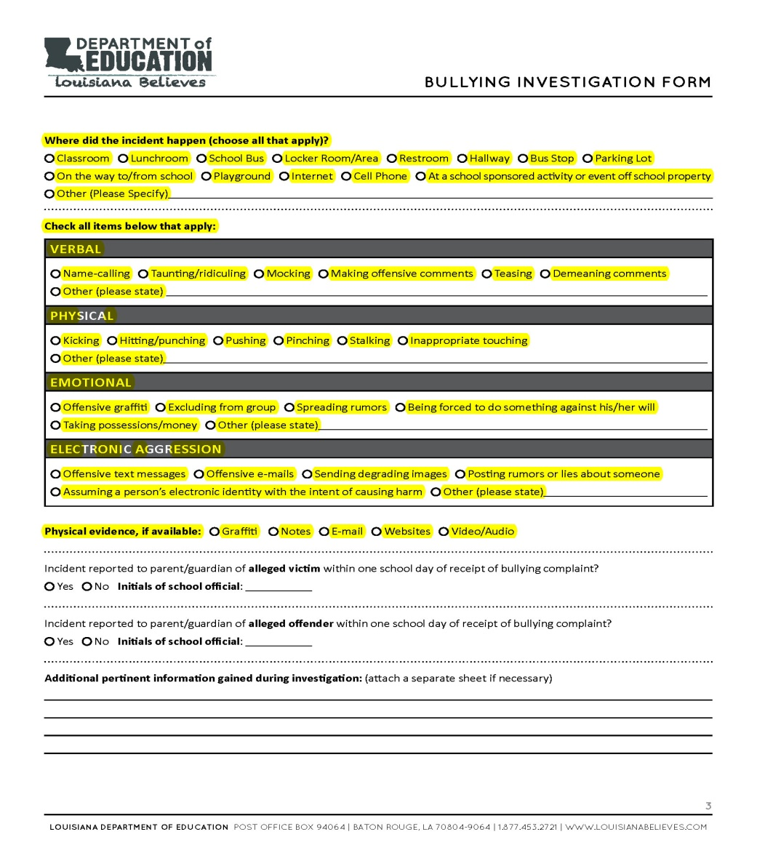
Bullying Investigation Form
Page 3
Notes:
The Bullying Investigation Form must be used by the principal or designee during an investigation into an incident of bullying. It was designed to be both an interview form and data collection instrument. All relevant information to the investigation will be collected in one document to streamline the process.
Most importantly, embedded into the new bullying investigation form are the required bullying data elements that an LEA must submit to the Louisiana Department of Education. This information was previously collected on the Bullying Incidences Checklist. For example, Page 3 of the investigation form above includes many of these data elements.
The Bullying Incidence Checklist mandated by Act 755 of 2010 still exists; however, it is integrated into the new investigation form. LEA’s no longer have to use the hard copy forms, but may still choose to do so as a part of their procedure.

Slide 16
School/Principal/Designee Responsibilities
Findings of Bullying Investigation
The principal/designee will compose a written document containing the findings of the investigation and the decision by the school
The principal/designee will promptly notify the complainant of the findings of the investigation and that remedial action has been taken, is such release of information does not violate the law.
The document outlining the findings of the investigation will be placed in the record of both students.
All complaints and investigative documents must be kept for three years.
Notes:
The principal or designee must compose a document containing the findings of the investigation, and all parents must be informed of the outcome of the investigation.
Act 861 requires that the findings of the investigation be placed in the record of both the victim and offender. This documentation must be kept for three years.

Slide 17
Principal/Designee Responsibilities Flowchart
Principal/Designee Responsibilities Flowchart
Disposition at the School Level
This chart may be used by a principal or his/her designee to meet the procedural requirements of Act 861. It is recommended that this chart be used as a “cheat sheet” to uphold the timeliness and integrity of the investigation into an act of bullying. This chart is available on the LDOE website.
Notes:
As an additional resource, the department has created a “principal or designee responsibilities flowchart.” This flowchart may be used as a “cheat sheet” to uphold the timeliness and integrity of the investigation into an act of bullying.
This chart can be found in the Bullying Prevention Toolkit on the Department’s website.

Slide 18
Parental Rights
Notification
Parents/legal guardians must receive a written copy of the school’s policy prohibiting bullying.
The parent/legal guardian of the victim and alleged offender must be informed when the school receives a report of bullying involving their child.
Any parent/legal guardian whose child was involved in an incident of bullying should have the opportunity to attend any interviews with their child conducted as a part of the investigation.
Any parent/legal guardian must be informed of the outcome of the investigation.
***Notification must be consistent with the student privacy rights under the applicable provisions of the Family Educational Rights and Privacy Act of 1974 (FERPA)
Notes:
At this time we will briefly discuss the rights that parents have through Act 861. As previously discussed, parents and legal guardians must be notified of the school’s policy against bullying and know how to appropriately report an incident of bullying to the school.
The parents or legal guardians of the victim(s) and alleged offender(s) must be informed if their child in involved in an incident of bullying. They have the right to attend the interviews with their child to provide input.
It is important to remember that notification must be consistent with student privacy rights under FERPA. No parent or legal guardian may learn the name of any student involved in the incident from a school or district employee. All interviews must be held privately and confidentially.

Slide 19
Parental Rights
Appeal/Parental Relief
The parents/legal guardians of a bullied student may request a transfer to another school if a parent, legal guardian, teacher, or other school official has made four or more reports of separate instances of bullying and no investigation has occurred.
The LEA must make a space available for the student at another public school under its jurisdiction within ten days of the transfer request.
If no other school that serves the bullied student’s grade is available, within fifteen days of the transfer request, the superintendent or head of the LEA must facilitate the student’s enrollment in a statewide virtual school or offer placement in a full-time virtual program or virtual school.
Notes:
Act 861 provides rights to parents or legal guardians who have made four or more reports of separate instances of bullying and where no investigation has occurred. This appeal right also applies if teachers or other school officials have made reports.
The school district must make space for that student in another school which serves the student’s grade level. If there is no other school in the district, the parent may request the student be transferred to another district or enroll the student in a virtual school.

Slide 20
Parental Rights
Appeal/Parental Relief
The LEA may enter into a memorandum of understanding with another LEA to secure placement and transfer for the bullied student.
If none of the aforementioned options are made available within 30 days of the transfer request, the parent/legal guardian may request a hearing with the school’s governing authority.
The parents/legal guardians may request at the end of the school year that the student be transferred back to the school in which the student was enrolled when at least three of the bullying reports were made.
The LEA must make space available for the student at the school where the student was originally enrolled. No other school will qualify for such a transfer.
Notes:
The law talks extensively about the rights to transfer and what a parent may do if the transfer request is not being met in a timely manner.
The law also provides the option for the student to be transferred back to the original school after the end of the school year.

Slide 21
Parent/Legal Guardian Rights & Responsibilities Flowchart
Parent/Legal Guardian Rights & Responsibilities Flowchart
This chart may be used by a parent or legal guardian to understand his/her rights and responsibilities as it pertains to Act 861. This chart is available on the LDOE website.
Notes:
To facilitate understanding of this complex law for parents, the Department has created a “parent or legal guardian right and responsibilities flowchart.” This flowchart will soon be posted on the Department’s website as a component of the Bullying Prevention Toolkit.

Slide 22
Louisiana Department of Education Responsibilities
Post and track any complaints received at the Department on the LDOE website
If the school and school board does not take timely and effective action, the student, parent, or other school employee may report the bullying incident to the LDOE. The LDOE shall:
Track the number of reports
Notify the Superintendent and the President of the LEA
Publish the number of reports by school district on the LDOE website
Notes:
Last, we will discuss the requirement the law placed on the Department regarding posting and tracking any incidents of bullying. The law provides that an investigation into an incident of bullying at the school level must be complete in 10 days from receipt of the written report. If the investigation is not complete, a student, parent, teacher, or other school employee may report the incident to the school board. The school board then has 10 days to investigate the incident and provide a resolution.
If the school and school board does not take timely and effective action, a student, parent, teacher, or other school employee may report the incident to the Department.
The Department has created an internal procedure for verifying complaints received. If the complaint is legitimate, and the school and school board did not meet its obligations, the Department is required by the law to notify the Superintendent of the LEA and publish the number of verified incidents on the Department’s website.

Slide 23
Professional Development and Training Resources on Bullying
Bullying Prevention Resources from the U.S. Department of Health and Human Services
www.stopbullying.gov
US Department of Education Safe and Supportive Schools Technical Assistance Center: Creating a Safe and Respectful Environment in Our Nation’s Classroom
http://safesupportiveschools.ed.gov/index.php?id=1480
Bullying Prevention Training Module and Community Action Toolkit
http://www.stopbullying.gov/blog/?p=174
Bullying Prevention Webinar
http://safesupportiveschools.ed.gov/index.php?id=9&eid=16
Bullying Prevention Professional Development for Bus Drivers
http://safesupportiveschools.ed.gov/index.php?is=9&eid=436
Notes:
Before we conclude the presentation, the Department has put together various resources for schools and school districts around the topic of bullying. These optional resources may be used for informational purposes and may assist LEAs with meeting the training requirements of Act 861.
These and other resources around Act 861 may be found in the Bullying Prevention Toolkit on the Department’s website.

Slide 24
Contact Information
Bullying Prevention in Louisiana’s Schools http://www.louisianaschools.net/topics/bullying_prevention_schools.html
For questions or comments about Act 861 please contact:
Robert Schaff, Section Leader, School Climate Section
robert.schaff@la.gov
(225) 219-0367
Lillie Burns, School Climate Section
lillie.burns@la.gov
(225) 219-0365
For questions or comments about this Act 861 PowerPoint please contact:
Crystal Wilkinson, School Climate Section
Crystal.wilkinson@la.gov
(225) 219-0422
Notes:
This concludes the presentation on Act 861. Any questions regarding the implementation of Act 861 should be directed to Rob Schaff or Lillie Burns. Any questions regarding the information and resources contained in this presentation should be directed to Crystal Wilkinson.
All questions received throughout the year will be used to regularly revise a “frequently Asked Questions” document on the Bullying Prevention in Louisiana’s Schools page on the Department’s website.
All of the documents referenced in the presentation may be found on the Bullying Prevention in Louisiana’s Schools webpage on the Department of Education’s website.

